Slide 1
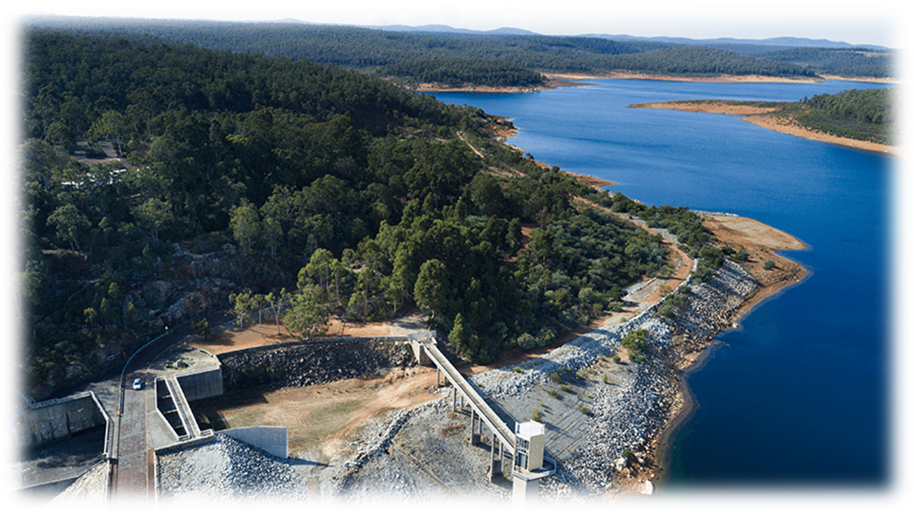
Peel Regional Water Supply Initiative

Slide 2
Who we are
City of Mandurah
Shire of Serpentine Jarrahdale
Shire of Murray
Shire of Boddington
Shire of Waroona
Peel-Harvey Catchment Council
Peel Community Development Group
Regional Development Australia – Peel
Peel Development Commission (Observer)
Pillars
Community
Economy
Environment

Slide 3
Planning Workshop February 2021 –
#1 Agreed Priority ‘Provision of Water to the Region’
Community – provision of reticulated potable water and sewerage infrastructure for residential growth; and non-potable water for public open space and community infrastructure
Economy – concerns about the sustainable supply of non-potable water for immediate and future need of agriculture, industry, mining and economic diversification opportunities
Environment - ensuring that the wetlands, waterways and overall environment are sustained as highly functioning ecosystems

Slide 4
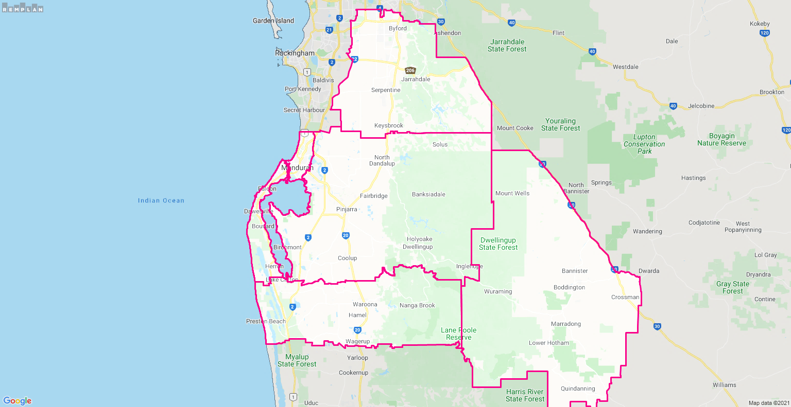
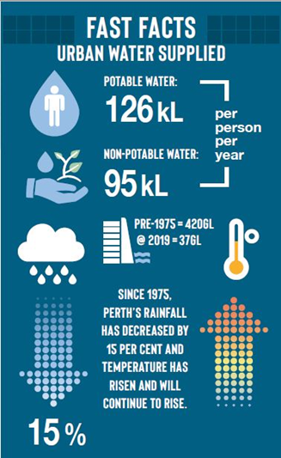
2036: + 83,590 residents
2050: + 187,000 (221kL pp)
Eg SJ POS watering deficit 1.37GL by 2050
New industry
Existing industry/mining
Dams 15% IWSS
Surface Water licences
Wastewater Treatment Plants
Desal 43% IWSS
Groundwater 39% IWSS
70% total water used
Rain -15% since 70’s
Groundwater -1.8m
+ 32,000
610,375KL
+34,575
+17,016
15 GL/yr
32 GL/yr
Notes:
Dams are now largely used as reservoirs for the IWSS with only 15% of the supply coming from rainfall catchment – includes Serpentine Main, Serpentine Pipehead, North Dandalup & South Dandalup. Boddington is serviced by Harris Dam.
Surface water relates to taking of water from rivers and catchments – 610,000kL downstream from Serpentine for landowners; Newmont Gold holds a 15GL/annum licence from the Hotham River – unsure of actual takings.
Harvey Water has a 32 GL/annum licence from Harvey, Wellington, Wokalup, Drakesbrook, Logue Brook & Waroona. An average 50% take up of this due to low catchment levels.
Wastewater Treatment Plants – opportunity to recycle wastewater. Gordon Road currently investigating use for 9GL/year. Woodman Point currently discharges 50 GL/year – this is where SJ wastewater is discharged.
Desalination – Kwinana & Binningup now supply 43% of integrated water supply
Groundwater – makes up 39% integrated water supply but when domestic supply included (eg domestic bores) it is 70% of all water used. Ground water allocation plans indicate full or over-allocation in most areas.
Environment – estuary & waterways severely impacted by reduction in rainfall & rising sealevels. Retention time of water in the estuary is comparable to pre-Dawesville Cut. Nutrients remaining in system longer; groundwater levels are exposing wetlands and acid sulfate exposure in drying lake beds.

Slide 5
What we don’t know
Potential external stakeholders and opportunities to work together
Articulating the challenges

Slide 6
Facilitated Workshop
14 organisations
Peel Alliance
Peel Development Commission
Peel-Harvey Catchment Council
City of Mandurah
Shire of Serpentine Jarrahdale
Shire of Murray
Shire of Waroona
Department of Planning, Lands and Heritage (DPLH)
Department of Biodiversity, Conservation and Attractions (DBCA)
Department of Water and Environmental Regulation (DWER)
Department of Primary Industries and Regional Development (DPIRD)
Water Corporation
Harvey Water
Urbaqua (facilitators)

Slide 7
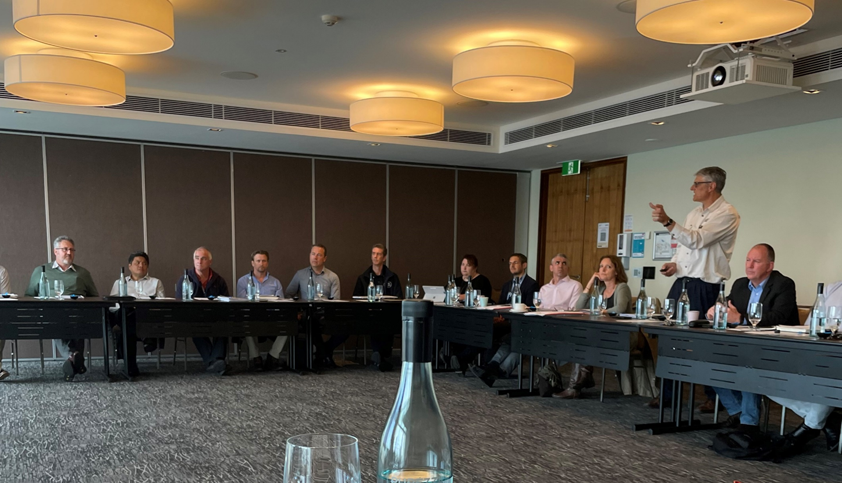

Slide 8
Agreeing the Problem
‘The sustainable management of water for community, environmental and economic needs in the Peel Region to support the delivery of organisational goals’
Planning horizon to 2050 – staged consideration and planning will be critical
Uncertainty as we plan further into the future – agree on scenarios and assumptions
Climate change impacts
Water demands and availability in both a temporal and spatial context
Quality of water required and quality of sources

Slide 9
Agreed Work Packages
The timing and magnitude of community needs to 2050 – assess the amount of water needed by each local government now and in the future to deliver planned, business as usual development on the basis of Perth and Peel @3.5million and aspirations contained in Strategic Community Plans. This should be linked to milestones and timing for delivery. Consideration should be given to the opportunities for and effect of changes to business-as-usual roll-out of development on water demands.
The timing and magnitude of agricultural needs to 2050 - Refine objectives and scenarios from the Peel food zone study and extrapolate (using this approach or others as deemed appropriate by the group) to the rest of the Peel region to document agricultural water needs at various stages to 2050.
The timing and magnitude of industrial needs to 2050 (light, general and heavy industrial).
The timing and magnitude of environmental water needs to 2050, recognising that sufficient site-specific ecological information is not currently available and that some assumptions will be necessary.
The range, timing and magnitude of water source options available and order of magnitude costs for planning, construction and operation. Commentary should also be provided on willingness to pay and current funding and delivery frameworks.

Slide 10
Environmental Water Needs
Stakeholder Reference Group: DBCA, DWER, PHCC, Western Australian Biodiversity Science Institute, 5 LGA’s
Undertake an assessment of the timing and magnitude of environmental water needs now and to 2050 to protect the ecological value of these wetlands and waterways, on the basis of currently available information.
Identify and spatially define the regionally significant water dependent environmental assets in the Peel Region
Summarise current knowledge of the health of these assets including their ecological water requirements (quantity and quality), any existing environmental water provisions, and relevant water allocation plans.
Based on the information collected from above:
* Briefly document the likely impacts of projected climate change on the health of these significant environmental assets in the Peel region under the current regime of water allocation scenario.
* Provide comment on what changes to the current regime need to be implemented (if any) to maintain the current ecological character of the asset under future climate change projections.
Develop a broad-scale water balance of the catchment depicting the current state and at 2050

Slide 11
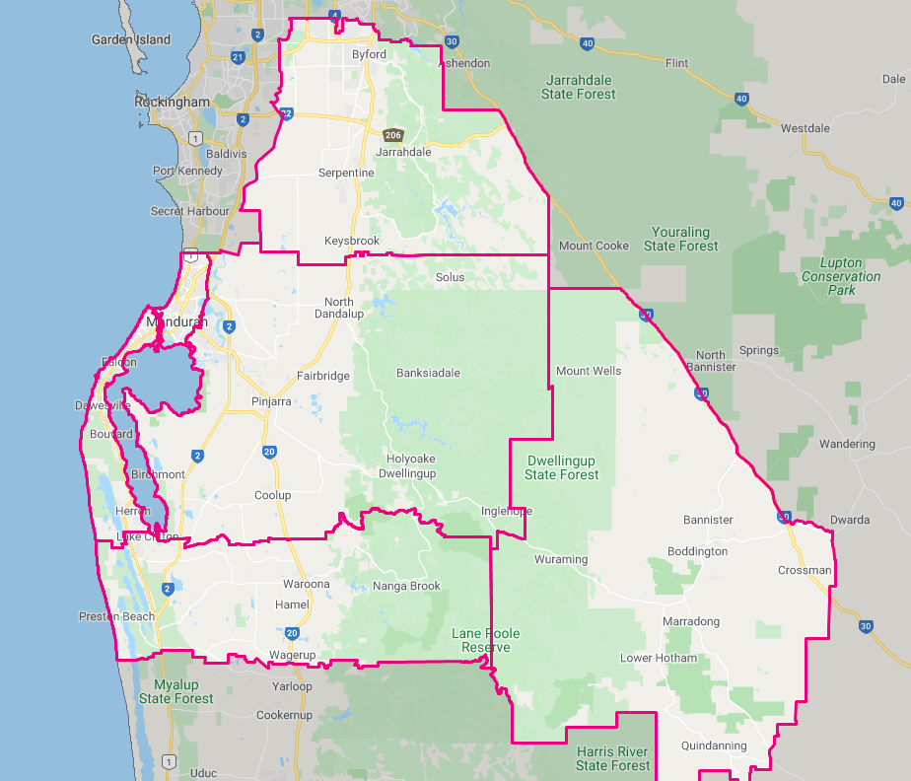
Next Steps
Funding Committed - PDC, Peel Alliance, DPIRD, Harvey Water
Procurement for Consultant led by Peel Alliance
Stakeholder Engagement
Key Deliverables – agreed scenarios, assumptions and calculation methodology
Map layers showing temporal and spatial water demand, sources and quantities
Gaps, critical milestones, opportunities and costs

Slide 12
Thank you

